Slide 1
COMPUTER SCIENCE
Cloud-Based Healthcare Management System
GROUP PROJECT

Slide 2
TABLE OF CONTENTS
Project Overview
Requirement Analysis
Software Requirement Specifications
Use Cases
Function Points & Effort Estimation
Data Flow Diagram
Technology Platform
Application Snapshot
Future Enhancement
Conclusion

Slide 3

PROJECT OVERVIEW :
A Cloud-Based Healthcare Management System is designed to streamline medical data storage, patient management, and doctor-patient interactions using cloud computing. It provides secure, real-time access to medical records, appointment scheduling, and telemedicine services.

Slide 4
REQUIREMENT ANALYSIS :
A Cloud-Based Healthcare Management System designed for hospitals and clinics to manage patient records, appointments, and medical history securely which require software and hardware such as
Softwares Requirements :
Operating System: Windows/Linux/MacOS
Platform: Cloud-based (AWS, Azure, Google Cloud)
Database: SQL Server / Firebase / MongoDB
Language: Java, Python, or Node.js
Hardwares Requirements :
Minimum Intel Core i5 processor or equivalent
8GB RAM, 1TB cloud storage
Stable internet connection
Security Considerations :
End-to-end encryption for data security
Two-factor authentication for login
HIPAA & GDPR compliance for data privacy

Slide 5
Software Requirement Specification :
Functional Requirements | Non-functional Requirements
User Management | Performance Requirements
Appointment Scheduling | Security Requirements
Electronic Health Records (EHR) | Availability & Reliability
Telemedicine & Consultations | Scalability & Maintainability
Prescription Management
Billing & Payments
Notifications & Alerts
Reports & Analytics

Slide 6
Use Cases :
Book an Appointment
View Medical Records
Update Patient Diagnosis
Process Payment for Consultation
Conduct Telemedicine Consultation

Slide 7
Function Point
Function point can used to
Estimate the cost or effort required to design, code and test the software.
Predict the numbers of the errors that will be encountered during the testing.
Forecast the number of component and/or the number of projected source code lines in the implemented system.
Effort Estimation
Work effort is the labour required to complete an activity. Work effort is typically the amount of focused an uninterrupted labour time required to compute an activity.

Slide 8
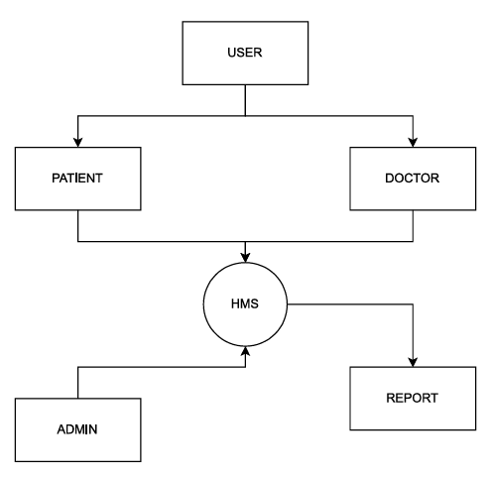
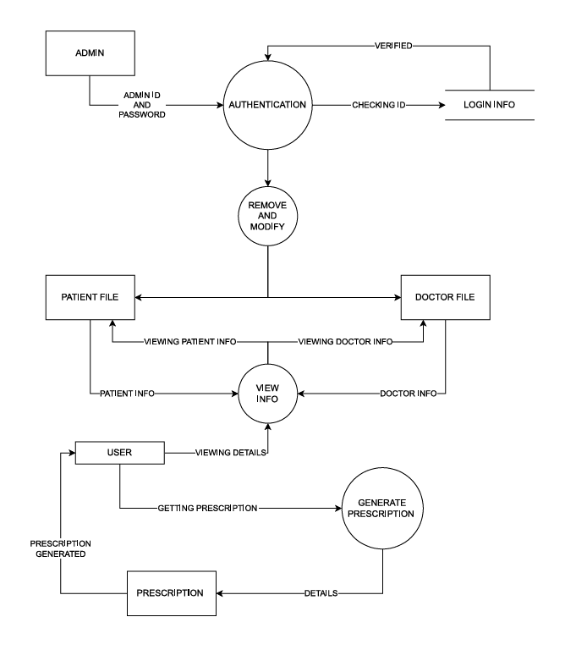
Data Flow Diagram
Level 0
Level 1

Slide 9
Technology platforms :
Web Platform: Cross-platform (accessible via browsers)
Application Development Framework: HTML, CSS, JavaScript
Backend Language: PHP / Node.js / Python (based on implementation)
Database: MySQL / MongoDB
User Interface Language: HTML & CSS
API Integration: RESTful APIs for interoperability
Hosting Platform: Cloud (e.g., AWS, Azure, Firebase)
Security Protocols: HTTPS, Token-based Authentication
Communication Medium: Email, SMS, or push notifications for alerts

Slide 10
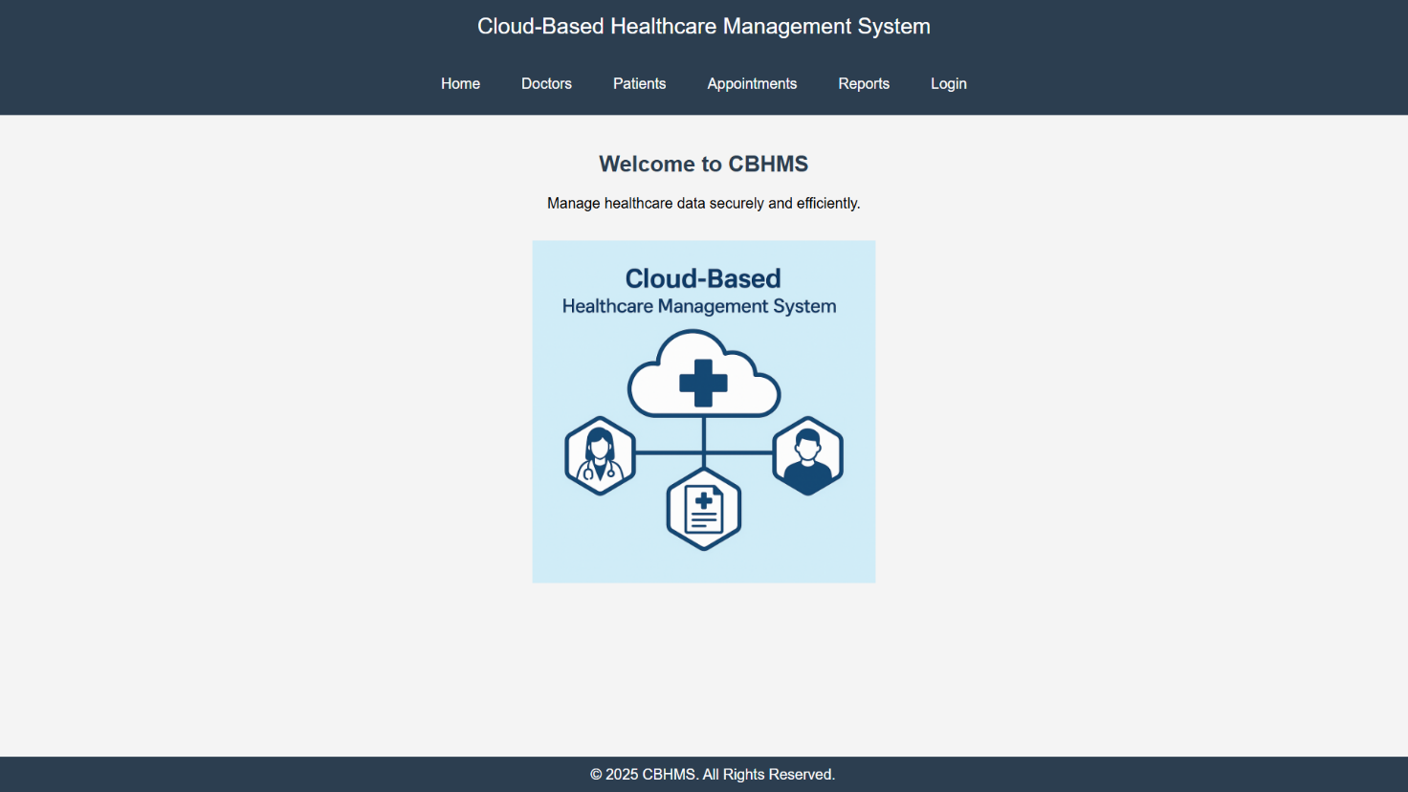
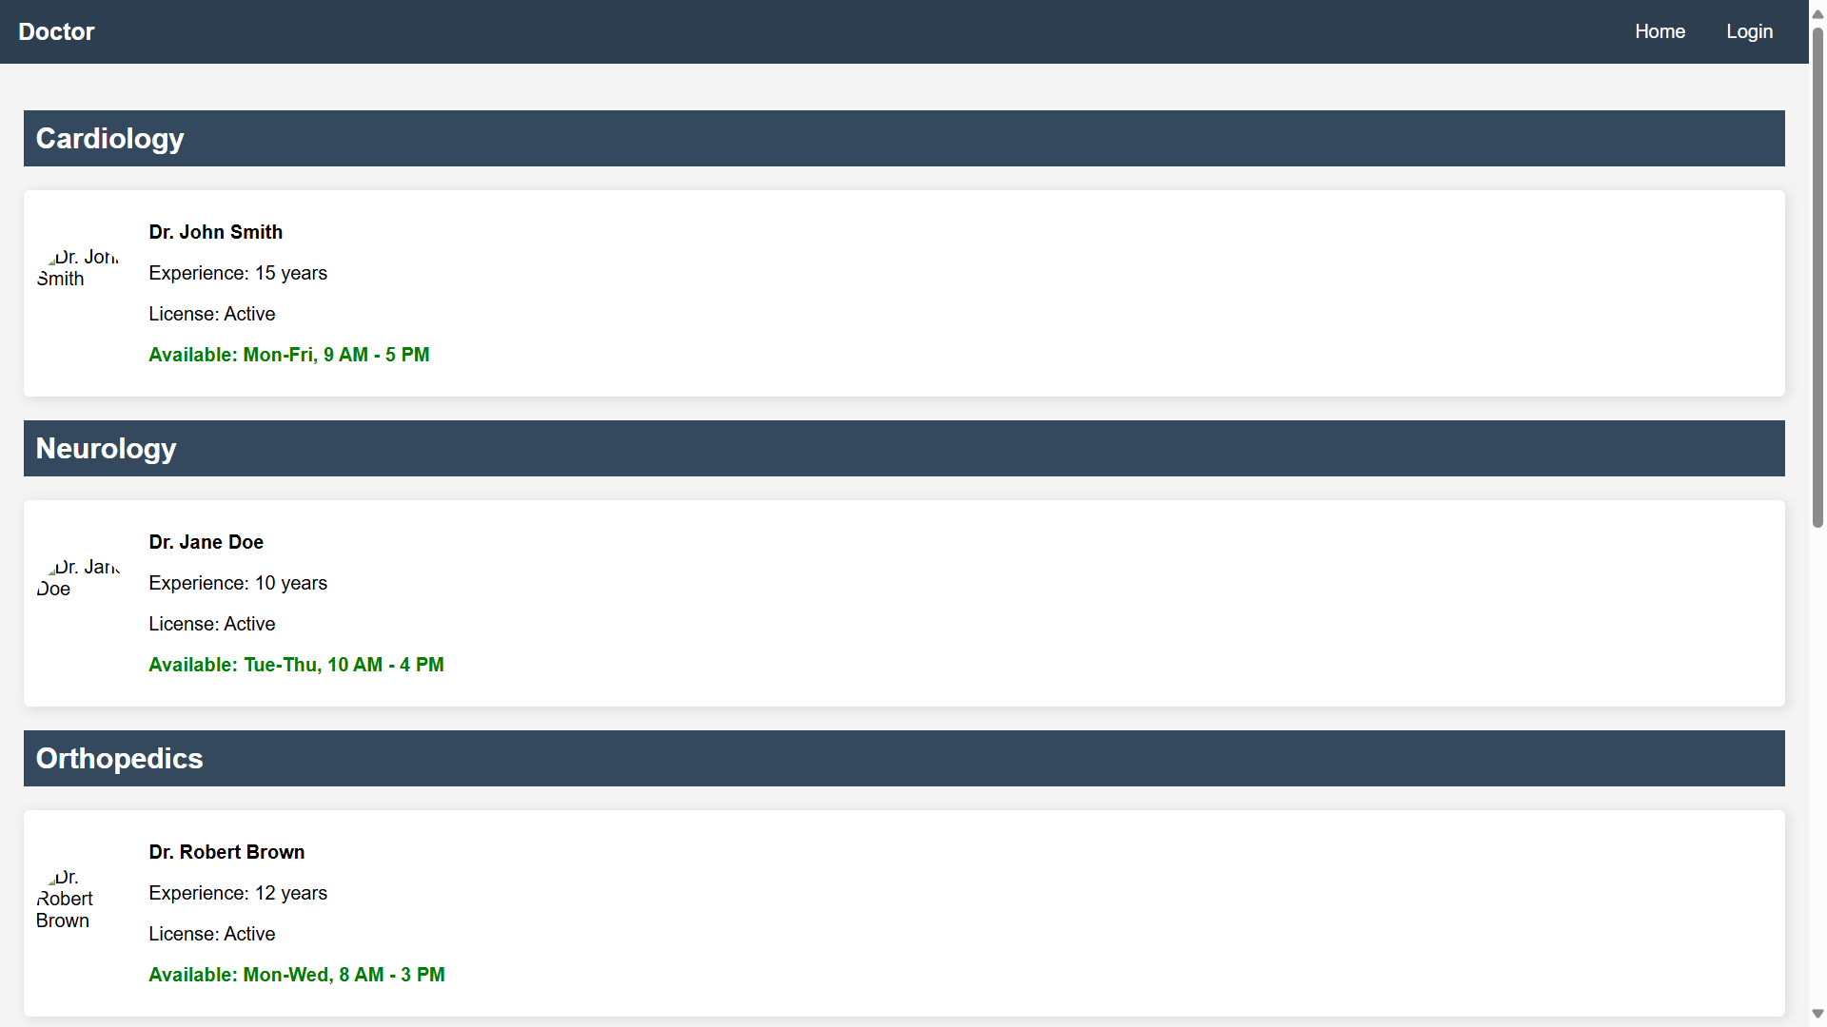
Application Snapshot :

Slide 11
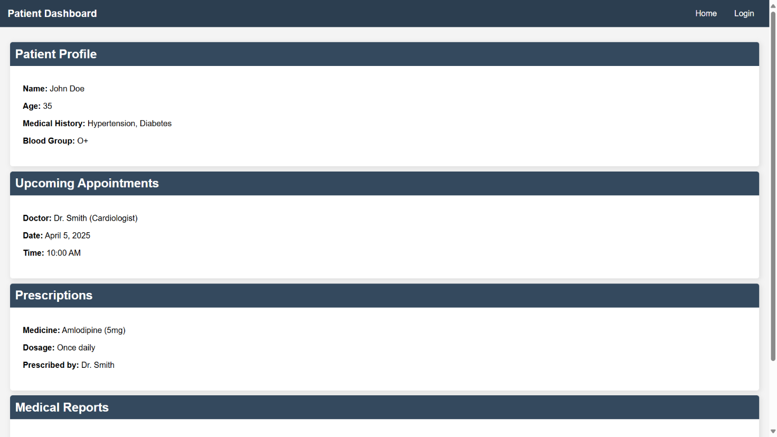
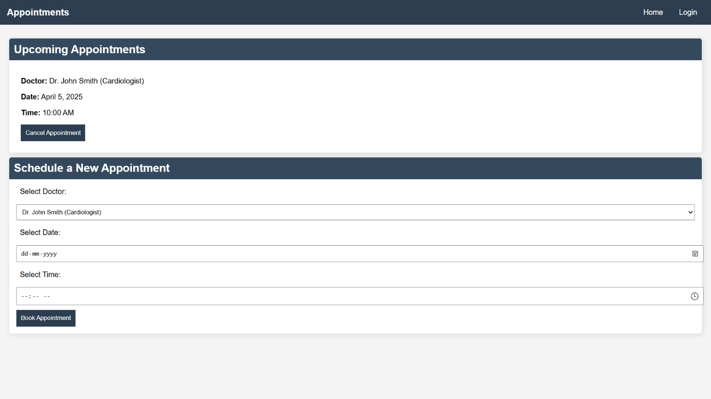
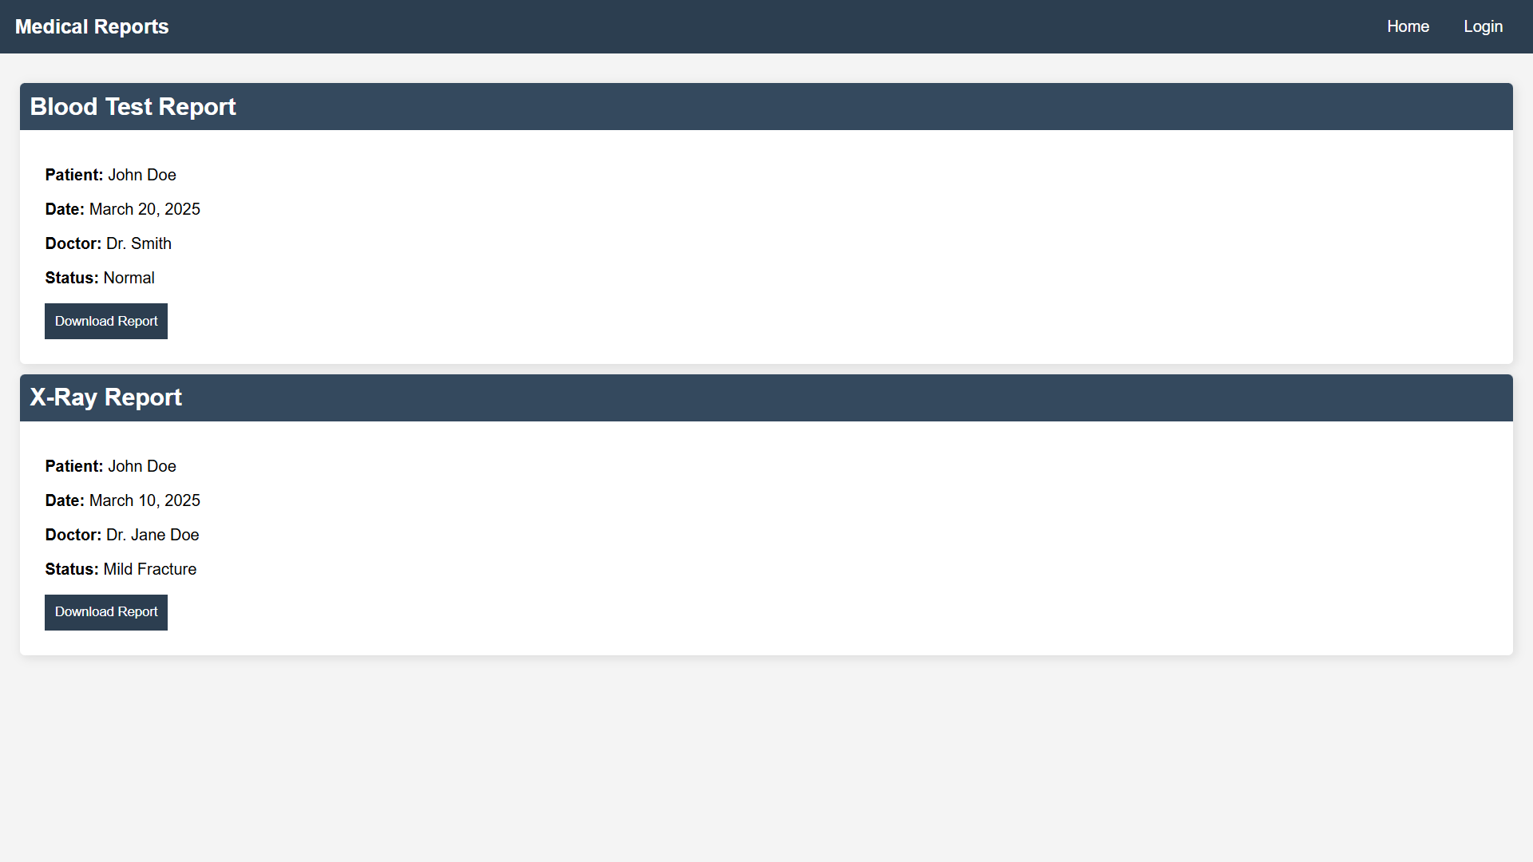
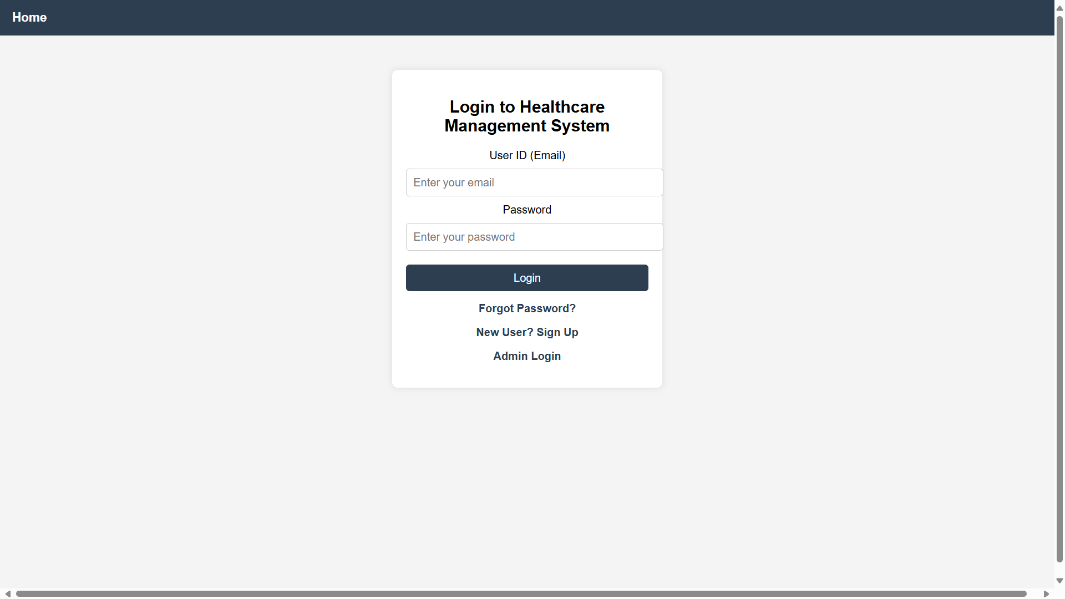

Slide 12
Future Enhancement
AI-powered symptom checker
Blockchain for medical record security
Wearable device integration (heart rate, BP tracking)

Slide 13
Conclusion :
The Cloud-Based Healthcare Management System (CBHMS) is designed to enhance healthcare services by digitizing patient records, streamlining doctor-patient interactions, and improving hospital management. By leveraging cloud technology, this system ensures secure, scalable, and remote access to healthcare data, benefiting both medical professionals and patients.

Slide 14
THANK YOU

